Slide 1
Homeostasis
Disruptions to homeostasis

Slide 2
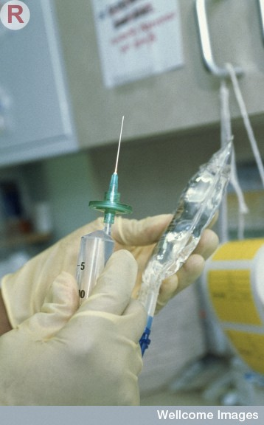
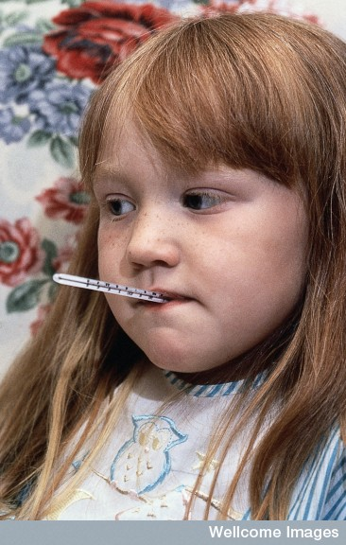
What happens if homeostasis fails?
If homeostasis cannot be maintained within tolerance limits, our body cannot function properly – consequently, we are likely to get sick and may even die.

Slide 3
Causes of disruptions
Hormonal imbalance
Behaviour
Disease

Slide 4
Hormonal imbalance
Diabetes
Thyroid

Slide 5
Diabetes
Diabetes is a disease characterised by abnormally high levels of blood glucose.
Diabetes results from the body being unable to maintain the blood sugar level in homeostatic balance.
It is a disruption caused by hormone imbalance

Slide 6
Type1 and 2 diabetes
There are several different types of diabetes. The most common are: Diabetes mellitus – Type 1 Diabetes mellitus – Type 2
Neither form of diabetes can be cured; however, both types can be managed through diet, exercise and the use of insulin.

Slide 7
Type 1
Also known as early onset diabetes because it often occurs in young people under the age of 30.
Type 1 diabetes is an auto-immune condition in which the immune system is activated to destroy the cells in the pancreas which produce insulin
Occurs because the pancreas stops making insulin.
Treated with daily injections of insulin (insulin-dependent).
Life-threatening if untreated.

Slide 8
Ketoacidosis
People with type 1 diabetes cannot use glucose as an energy source so their body burns fat and proteins instead.
Toxic compounds called ketones are a by-product (smell like nail polish remover on the breath).
If ketones accumulate in the body a life-threatening condition known as ketoacidosis can result.
If ketoacidosis remains untreated it results in total homeostatic disruption, followed by coma and death.

Slide 9
Type 2
Also known as late onset diabetes because it typically occurs in older people (over the age of 45).
Type 2 is the most common form of diabetes (85-90%).
Type 2 diabetes is a progressive condition in which the body becomes resistant to the normal effects of insulin and/or gradually loses the capacity to produce enough insulin in the pancreas.
Predominantly treated/managed by dietary control and exercise.
Life-threatening if untreated.

Slide 10
Type 2 – Lifestyle risk factors
Lack of physical activity
Overweight/obese
High fat, sugar, salt and low fibre diet
High blood pressure, cholesterol
Smokers

Slide 11
Affects of high blood sugar levels
High levels of blood sugar can damage blood vessels. This can lead to:
Blindness
Kidney failure
Cardiovascular disease
Loss of sensation
Ulcers and gangrene sometimes requiring amputation of the toes or foot.

Slide 12
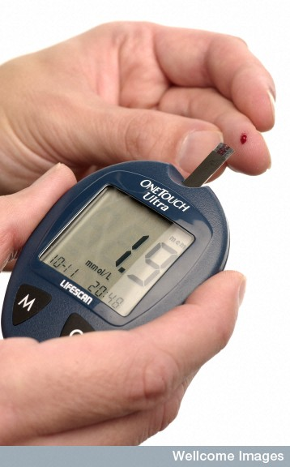
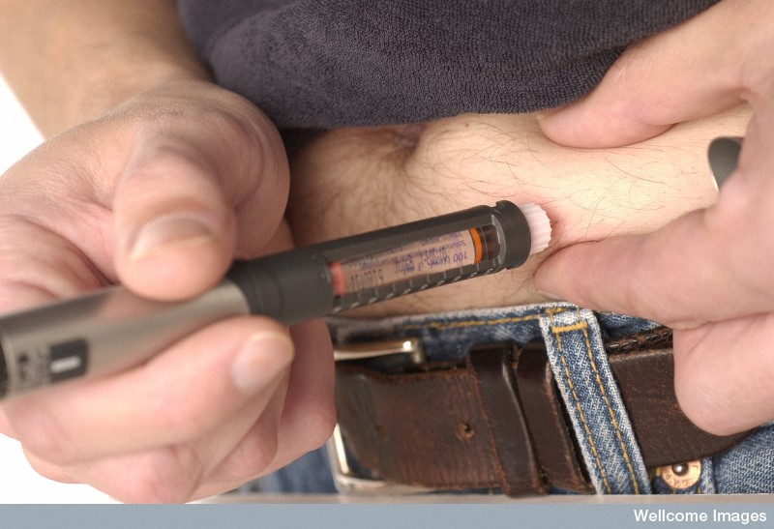
A man with diabetes using an electronic reader to measure the level of sugar in his blood.
Wellcome Library

Slide 13
The thyroid hormones
Major hormone released is thyroxine – it stimulates carbohydrate, protein and fat metabolism.
Regulates the base metabolic rate
Important in body changes needed between summer and winter.
Each molecule of thyroxine contains four iodine atoms.

Slide 14
Hyperthyroidism
The result of too much thyroxine being released (as a result of an enlargement of the thyroid gland)
Cells are overstimulated and this results in rapid heart beat, weight loss, increased appetite, fatigue, sweating and anxiety
Treatment involves drugs that block the thyroids use of iodine, removal of part of the gland, or drinking radioactive iodine which the thyroid cells take up and kills them.
Most commonly known as Graves’ Disease

Slide 15
Hypothyroidism
Result of too little thyroxine
Symptoms include slow heart rate, unexplained weight gain, fatigue, intolerance to the cold, swelling of the face, goitre.
Hashimoto’s disease – the immune system attacks the thyroid
Iodine deficiency. This causes the enlargement of the thyroid (goitre) in an attempt to increase hormone production which is in vain due to the body requiring more iodine.

Slide 16
Behavioural causes
Activities we choose that disrupt our bodies normal functioning:
Drugs
Excessive activity
Eating habits

Slide 17
Caffeine
Caffeine – stimulates metabolism and the CNS.
Binds to receptors on heart muscle fibres and mimics the effect of adrenaline, increasing heart rate. This causes increased blood flow through the kidney which increases urine production. This also causes increased blood flow through the lungs.

Slide 18
Alcohol
Depresses the CNS causing a relaxed feeling.
Stimulates insulin production, speeding up glucose metabolism and lowers blood sugar levels.
Inhibits production of ADH, causing urine output to increase and dehydration.
More information on drug action : https://thebrain.mcgill.ca/flash/i/i_03/i_03_m/i_03_m_par/i_03_m_par_alcool.html

Slide 19
Others
Amphetamine – cause the release of adrenaline, dopamine and serotonin, improving alertness and motivation. They also affect appetite and weight control.
Ecstasy – cause the release of noradrenaline, dopamine and serotonin. Initiating the flight or fight response – increases heart rate, blood pressure, breathing rate, sweating. Will result in dehydration and decreased appetite and a rise in body temperature and blood pressure.

Slide 20
Others
Cocaine – blocks the removal of dopamine, noradrenaline and serotonin from the synapse. Stimulation of the CNS increases heart rate, body temperature, blood pressure and breathing rate, appetite decreases
Heroin – a pain killer that causes a sense of euphoria. Slows down breathing rate, reduces blood pressure and body temperature, and can cause an irregular heart rate.

Slide 21
Excessive exercise
If nutrition is inadequate excessive exercise can cause the break down of protein in muscle to provide glucose. Muscle mass is decreased.
Cardiovascular problems can result from stress placed on the heart
Amenorrhoea – cessation of menstruation
Affect Calcium metabolism causing a loss of Calcium from the bone.

Slide 22
Deficiency diseases
Lack of iodine
Lack of iron – anaemia (lack of red blood cells). Unable to transport oxygen leading to high heart rate and blood pressure and fatigue
Vitamin K deficiency – necessary for blood clotting. Bacteria in the large intestine make most of our Vitamin K. In Australia babies are given injection of Vitamin K as very little is found in breast milk.

Slide 23
Obesity
Genetic factors
Over eating
Lack of physical activity.
Energy intake exceeds energy usage and the excess is stored as fat.

Slide 24
Disease
Emphysema
Fever
Hypertension
Renal failure

Slide 25
Emphysema
Lung disease in which the walls of the alveoli break down, reducing the surface area for gas exchange.
Commonly caused by smoking
Causes oxygen and carbon dioxide levels to be out of balance
Results in breathlessness during physical activity.

Slide 26
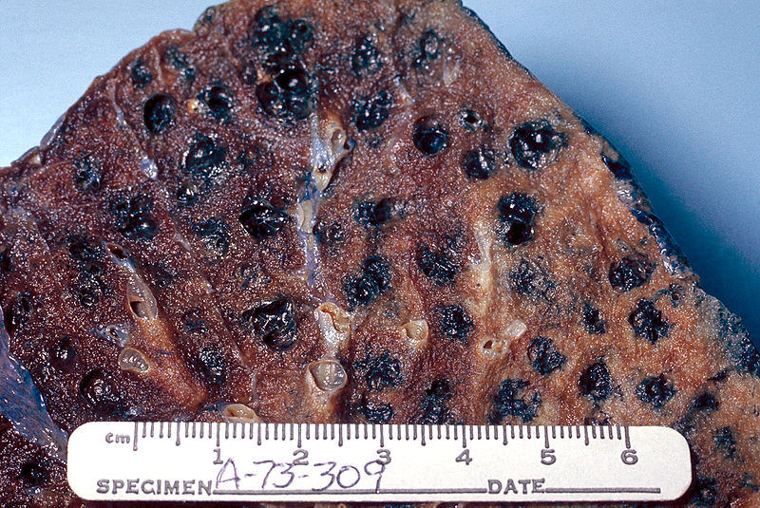
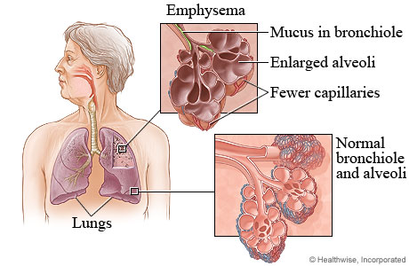
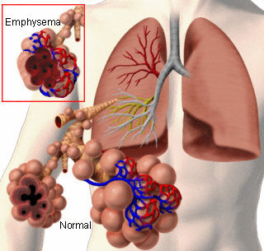
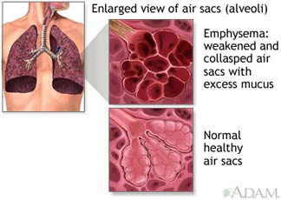

Slide 27
Fever
Many infections result in fever
Core temperature increases by 1 or 2 °C
Seems to help the immune system overcome infection

Slide 28
Hypertension
High blood pressure
Results when the body is unable to control blood pressure by normal homeostatic mechanisms.
Possible causes: Excessive salt intake, obesity, lack of exercise, excessive alcohol consumption, kidney disease.
Often can be prevented by healthy life style choices.

Slide 29
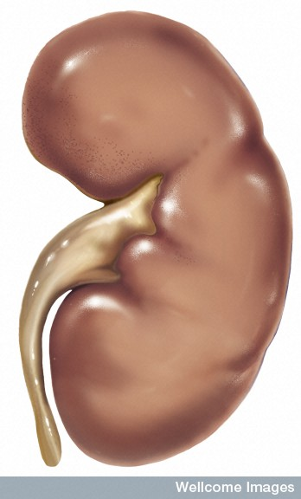
Renal failure
When the kidneys stop working homeostatic disruption is so widespread that the person will die unless they receive urgent medical assistance.
Medical Art Services, Munich, Wellcome Images

Slide 30
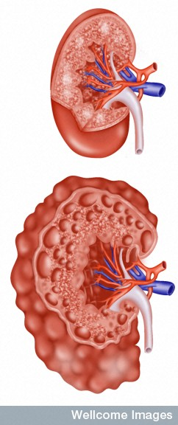
Causes of Renal failure
There are many causes for kidney failure – these can be classified as:
acute (sudden) resulting from causes such as toxic drugs, a blockage or injury.
chronic (gradual) resulting from problems such as diabetes, cancer, high blood pressure or polycystic kidney disease.
Polycystic kidney disease
Wellcome Photo Library

Slide 31
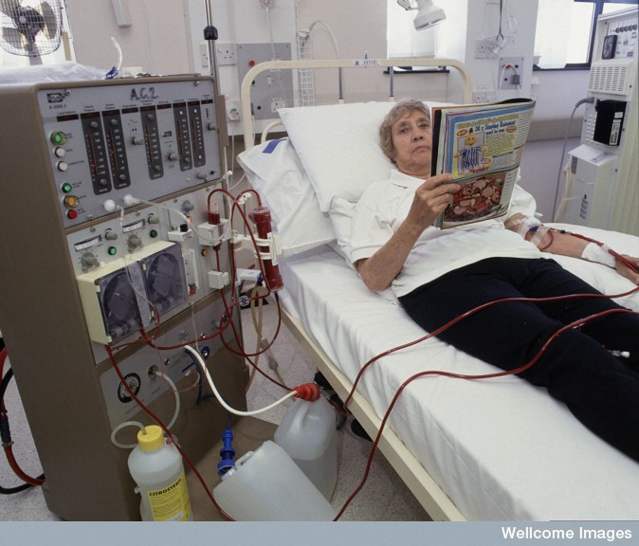
Haemodialysis
During haemodialysis blood is removed from an artery, toxic substances, metabolic wastes and excess fluid are removed, and the blood is then returned to the body
Wellcome Photo Library

Slide 32
Consequences of renal failure
In both acute and chronic renal failure, urine production is disrupted and water, salts and metabolic wastes are retained in the body.
This causes widespread homeostatic problems which affect almost every system of the body.
The most common cause of death is cardiovascular disease.

Slide 33
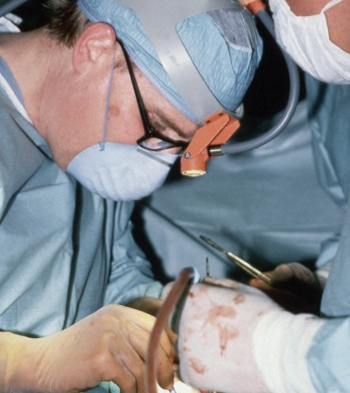
Treatment
Surgeons performing a kidney transplant
In many instances there is no cure for renal failure.
Many people with renal failure have to undergo regular haemodialysis treatment to purify their blood (conventionally three times a week).
Sometimes a kidney transplant is an option.
Wellcome Photo Library

Slide 34
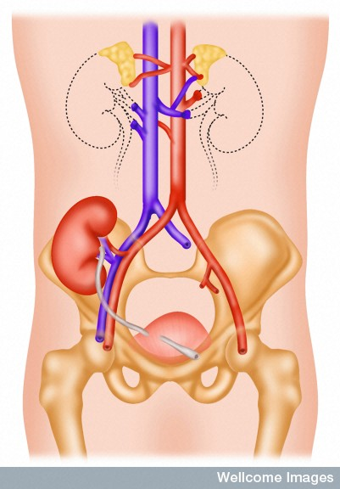
Kidney transplant
People with renal failure can receive a kidney transplant if a matching donor kidney is available.
The transplanted kidney is lower in the pelvis and attached to the common iliac artery and vein.
Wellcome Photo Library

Slide 35
Treatment of hormone related disruptions
Hormone replacement therapy
Corticosteroids

Slide 36
Menopause
When a woman’s ovaries stop producing eggs
Oestrogen and progesterone secretions ceases causing menstruation to cease.
Occurs approximately between the ages of 48 and 55 and may take between 2 and 5 years.

Slide 37
Symptoms of menopause
60% of women suffer mild symptoms for which no medical intervention is necessary.
About 20% of women suffer severe symptoms which can include:
Hot flushes, headaches, thinning and dryness of the walls of the vagina, frequent urination, reduced sex drive, tiredness, mood disturbances and sleeping difficulties
These women may be prescribed hormone replacement therapy.

Slide 38
Hormone replacement therapy
Women are given oestrogen and progesterone in low doses in the form of pills, patches or gels.
Some side effects include bleeding, bloating and breast tenderness. They also cause a small increase in the risk of developing breast cancer, cardiovascular disease and thrombosis (clotting in blood vessels).

Slide 39
Rheumatoid arthritis
When the immune system attacks the synovial membrane of joints resulting in swelling and deformity.
Corticosteroids act on the immune system and prevent the production of inflammatory or allergic responses.
However they also interfere with the functions of white blood cells resulting in a reduced resistance to infection.

